Slide 1

Project Presentation
on
Under the guidance
Praveen Mishra (Assistant Professor)
SEAT ALLOTMENT THROUGH FACE RECOGNITION
Presented By
Rahul Kumar Hemant Maurya
Roll No. 18365 Roll No. 18317
Department of information Technology
Institute of Engineering and Technology, Ayodhya

Slide 2
TABLE OF CONTENTS
Sr.No Topic of Project
Introduction of The Project
Project Aim & Objective
HW/SW Requirement
Flow Diagram
Process Seat Allotment

Slide 3
INTRODUCTION Of The Project
1. Seat Allotment is a Computer application that is capable of detecting,identifying or verifying the Human faces from an image or video capturing using a digital Camera and allocating their seat respectively.
2.It is a form of Biometric system.
3. System compare the scan to record stored in central or local database and show their information about Seat, Name, Roll No.
4. Seat allotment contain following two steps, first step concern the detection of faces and second step contain recognition of those identified face images with the existing database that contain existing image Scatter diagram of oriented angle and recognizing perform through deep learning.

Slide 4
5.The main use of seat allotment system for the direction of seat location is the quick and smartest way of Our seat and easy way to room number and all the information. Seat allotment is a more proper and faster technique among other approaches and scales down the chance of getting there seat very quickly and easily.
6. Our system accepts face recognition progress to slow down the defect of existing system with the help of deep learning, it have need a good quality camera to capture the images of students, the detection process is done by d by the camera is transfer to system for further analysis, the input image is then correlated with a set of reference images of each of the student and record the Seat information of the students

Slide 5
PROJECT AIM
1.The main aim of the project is to design and construct a Seat Allotment in examination at this pandemic scenario without any human interaction,
2.Seat Allotment is fully human touchless process.
3. Seat Allotment using face recognition system are very fast and reliable than the physical allotment .

Slide 6
PROJECT OBJECTIVE
The objective of this project is to implement a low cost , reliable and scalable Seat Allotment through face recognition system.
That can be used without human, using a camera and some devices.

Slide 7
REQUIREMENT
Hardware And Software
CAMERA/WEB CAMERA
LAPTOP
RAM-4GB
SSD-10GB
PYTHON
PYCHARM
OPERATING SYSTEM - WINDOWS OR LINUX
DATABASE

Slide 8
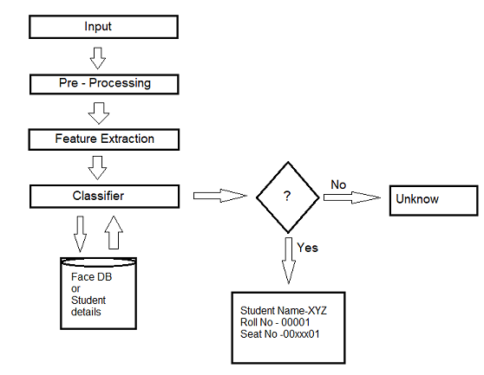
Flow diagram

Slide 9
Process in during Seat allotment using face recognition :-
Input:-
Firstly we make database of all student who are enrolling in seat allotment , we are taking at least 1 photo and their Name, Roll no. to making a database that help us to allocate seat respective and smoothly

Slide 10
Data Preprocessing
1.Data preprocessing is the process of transforming raw data into an understandable format.
2.It is also an important step in data mining as we cannot work with raw data.
3.The quality of the data should be checked before applying machine learning or data mining algorithms.

Slide 11
Why is Data preprocessing important?
And Major Tasks in Data Preprocessing:-
● Accuracy: To check whether the data entered is correct or not.
● Completeness: To check whether the data is available or not recorded.
● Consistency: To check whether the same data is kept in all the places that do or do not match.
● Timeliness: The data should be updated correctly. ● Believability: The data should be trustable.
● Interpretability: The understandability of the data.
Task:-
1.Data cleaning 2. Data integration 3. Data reduction 4. Data transformation

Slide 12
Feature Extraction
Feature extraction is a part of the dimensionality reduction process, in which, an initial set of the raw data is divided and reduced to more manageable groups. So when you want to process it will be easier. The most important characteristic of these large data sets is that they have a large number of variables. These variables require a lot of computing resources to process. So Feature extraction helps to get the best feature from those big data sets by selecting and combining variables into features, thus, effectively reducing the amount of data. These features are easy to process, but still able to describe the actual data set with accuracy and originality.

Slide 13
Process use in Image Extraction
1. We store image in Database .
2. Reading Image Data in Python
3. Method #1 for Feature Extraction from Image Data: Grayscale Pixel Values as Features
4. Method #2 for Feature Extraction from Image Data: Mean Pixel Value of Channels
5. Method #3 for Feature Extraction from Image Data: Extracting Edges

Slide 14
Image Classification Working
Image classification is a supervised learning problem: define a set of target classes , and train a model to recognize them using labeled example photos. Early computer vision models relied on raw pixel data as the input to the model.raw pixel data alone doesn't provide a sufficiently stable representation to encompass the myriad variations of an object as captured in an image. The position of the object, background behind the object, ambient lighting, camera angle, and camera focus all can produce fluctuation in raw pixel data; these differences are significant enough that they cannot be corrected for by taking weighted averages of pixel RGB values. To model objects more flexibly, classic computer vision models added new features derived from pixel data, such as color histograms, textures, and shapes.

Slide 15
Matching with Face database and result:-
After the performing there step we are match the face with our database if their detail are match than they get their seat information respectively and if their image in does not present in our database then they did not get their seat information.

Slide 16
THANK YOU

